Slide 1
Misty Rainforest
Sydney Eckstein, Stella Fruijtier, Richard Stoiberer

Slide 2



Team
Lead Programmer
Artist / Audio & UI Designer
Level & Game Lead

Slide 3
In the heart of the Misty Rainforest, where the air hums with ancient whispers, a man named Komea sealed his fate.
Driven by greed, he descended into the sacred depths-seeking the hidden riches of the Merfolk tribe. But the spirits of the deep do not forgive trespassers.
When Komea’s hands touched their treasures, the curse took hold. His flesh withered, his heartbeat silenced, and his bones were bound by spectral flame. Now, only a skeleton remains—cursed to remember what he once was.
Yet all is not lost. Legends speak of the Orazc Pearl, a relic born from the ocean’s first tear, resting within the heart of the Misty Rainforest itself. To touch it is to reclaim what was taken… but the Merfolk guard it fiercely, for it is the core of their soul, their most sacred treasure.
And so, Komea’s journey begins—into the mist, into madness, into redemption.

Slide 4
About
2D Jump & Run
Playtime 5 to 10 minutes
Windows PC & Apple Mac
For Casual Platform Fans (8+)
Komea’s Controls:
Jump > Space Bar
Run > A, D
Spear Attack > J
Interact > E
Game Menu > ESC

Slide 5
Rules
Complete Level
Scoring
Health
Your Score is time of completion, promotes replayability
Eliminate all Enemies before advancing to the next level on the right of the screen
If you get hit once by a Merfolk, you die and restart at Level 1
Merfolk health ranges from 2 to 5 spearhits (level dependent)

Slide 6
Game Progression
01
Level 1
Xilan Jungle: gentle platforming, 1-2 merfolk scouts
02
Level 2
River Caverns: add water to slow down character movement, more enemies
03
Level 3
Oracz Ascend: Gatekeeper Merfolk
Restart if you fail
04
The Ending
Transformation to Human Form

Slide 7
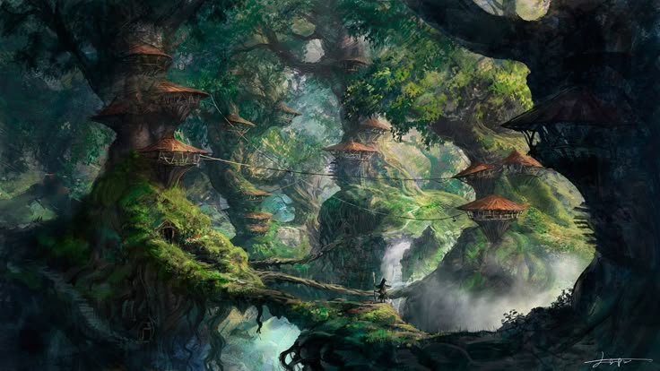
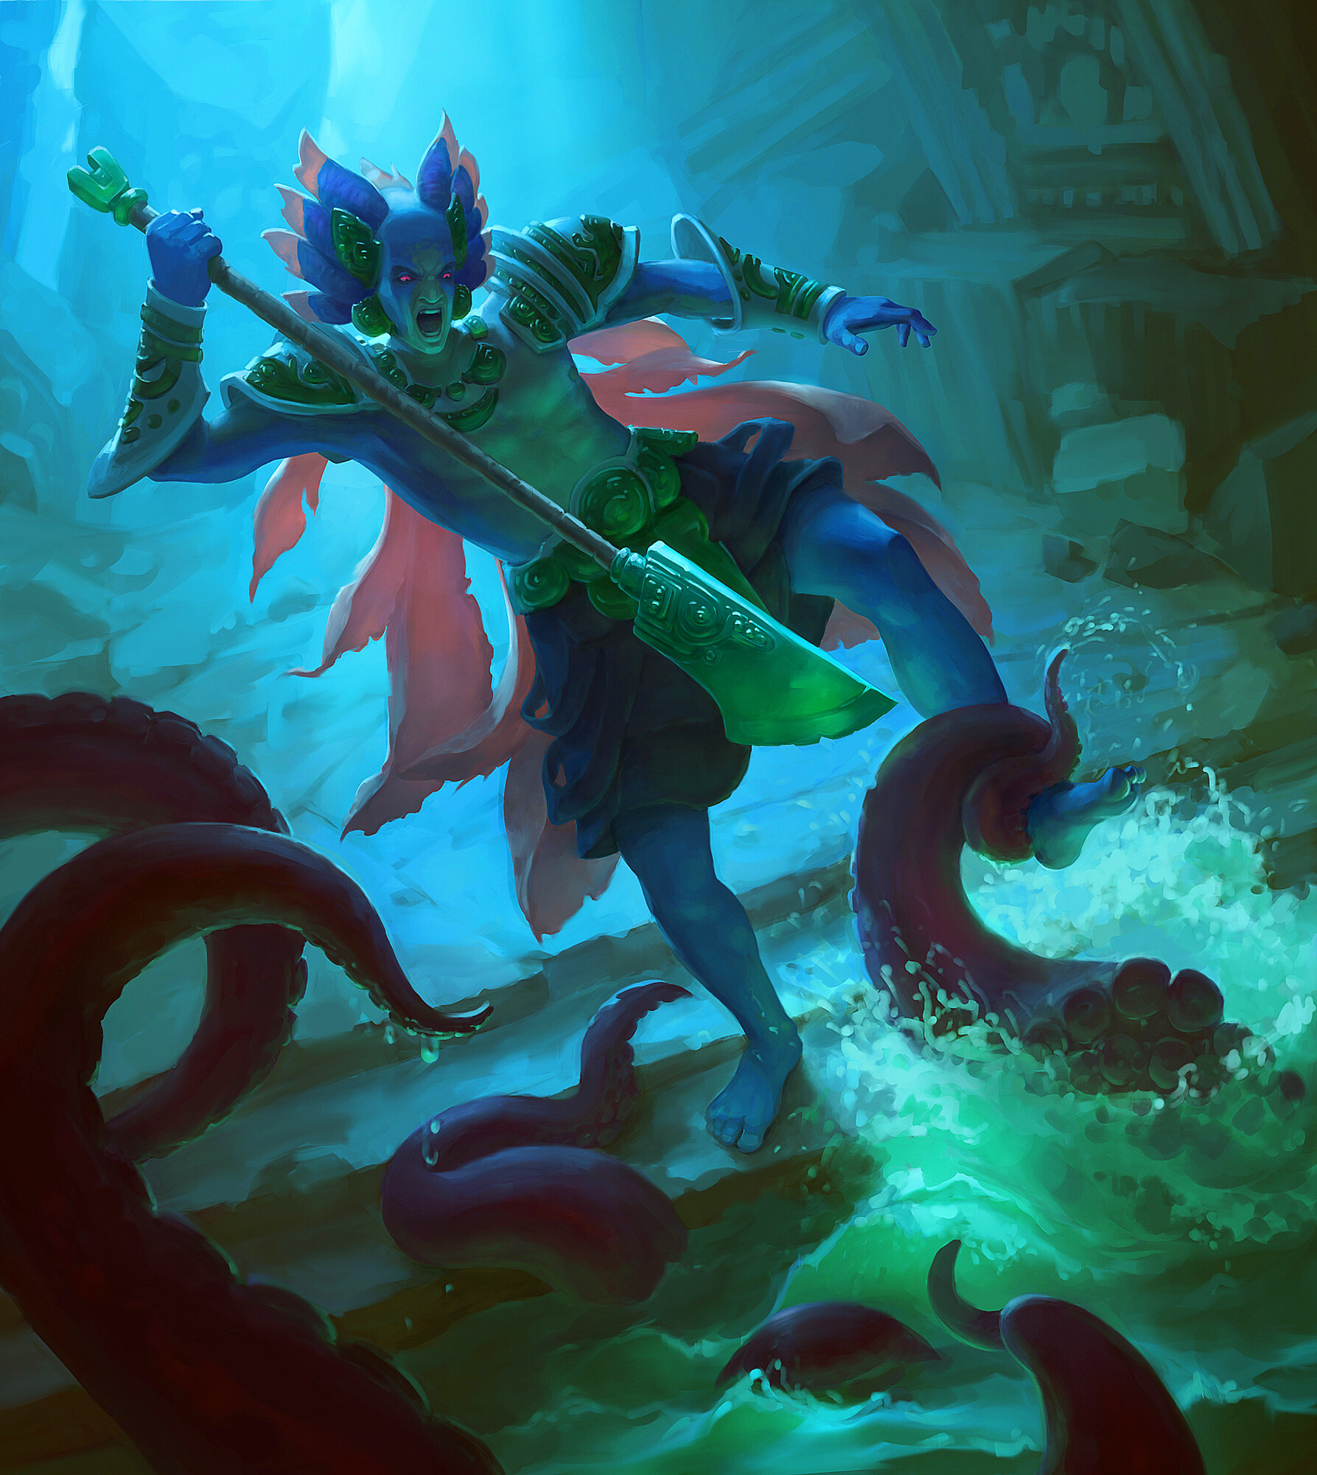

Sketches and Inspiration

